Slide 1
Network Engineering
RELIABILITY
∨
Performance Monitoring Automation
Today!

Slide 2




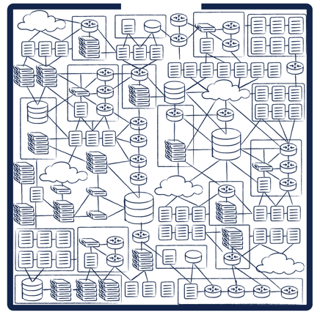







Since the 90s, we’ve built a global scale,
software-driven protocol robot.
Operations and monitoring still largely artisanal and crafted, like it’s the 90s.
DESIGN, DEVELOP & CONFIGURE, STAGE, DEPLOY…
(now operate it manually.)
Notes:
SDN, Fabric, Multivendor NOS, ACI, NSX, Ansible, Git…
But let me tell you about Apple, Google, FB, and Amazon…
Operations teams can’t scale to the speed of modern, orchestrated networks.
Operations teams aren’t staffed with computer science majors and software engineers.
Multivendor & software-defined networks make the problem worse!
Even learning CI/CD Pipelines and toolchains consumes too much time!
Old-school MIB Pollers are dead or dying.
Packet capture is expensive and violates privacy directives
https://www.opencompute.org/files/INT-In-Band-Network-Telemetry-A-Powerful-Analytics-Framework-for-your-Data-Center-OCP-Final3.pdf
Telemetry driven analytics and programming against a telemetry pipline.
teleme

Slide 3
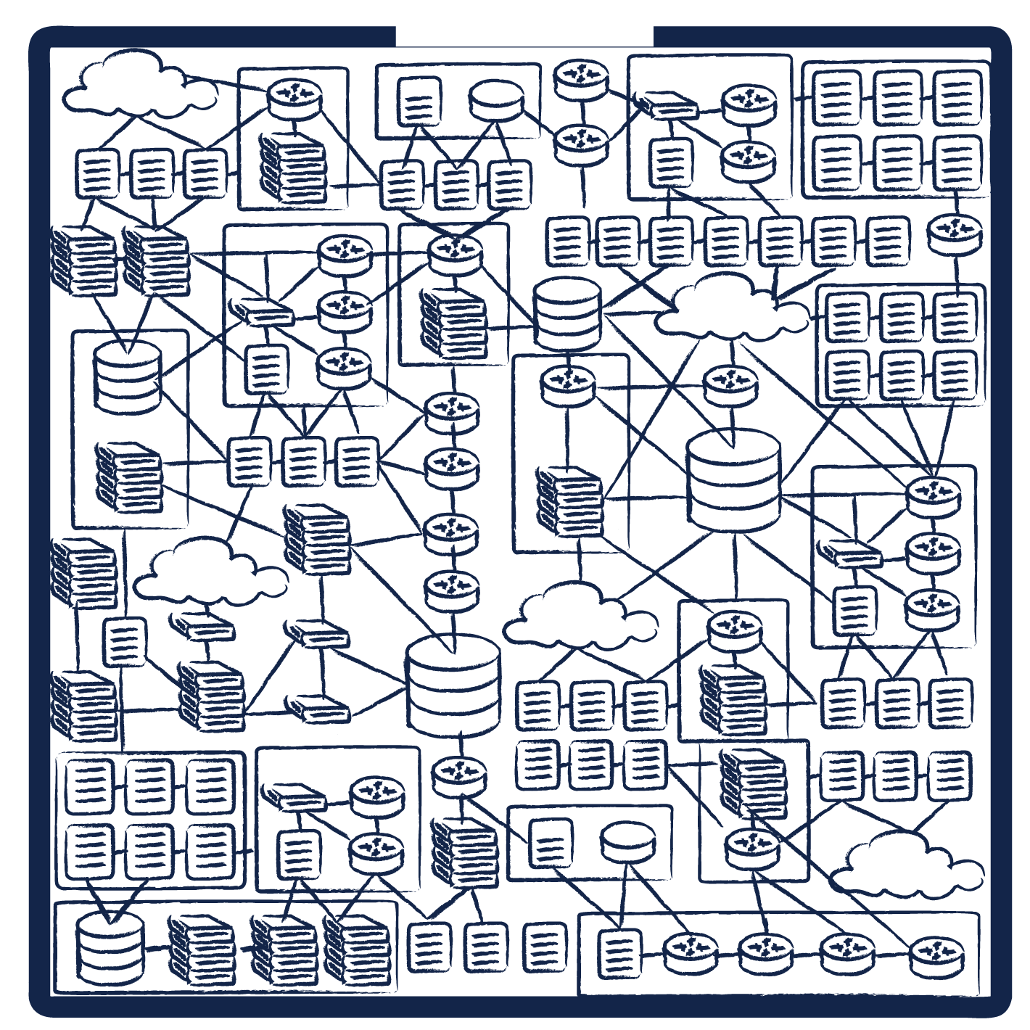
bridges the reliability gap
SDN, Fabric, Multivendor NOS, ACI, NSX, Ansible, Git…
DESIGN,
DEVELOPMENT
& CONFIG,
STAGING
DEPLOYMENT…
All the
problems
are here!
Notes:
Operations teams can’t scale..
Modern, orchestrated networks outpace human analysis.
Operations teams aren’t staffed with computer science majors and software engineers.
Old-school MIB pollers are dead or dying.
Packet capture is expensive and violates privacy directives
Multivendor & software-defined networks make the problem worse!
Learning CI/CD pipelines and data p and toolchains consumes too much time!

Slide 4
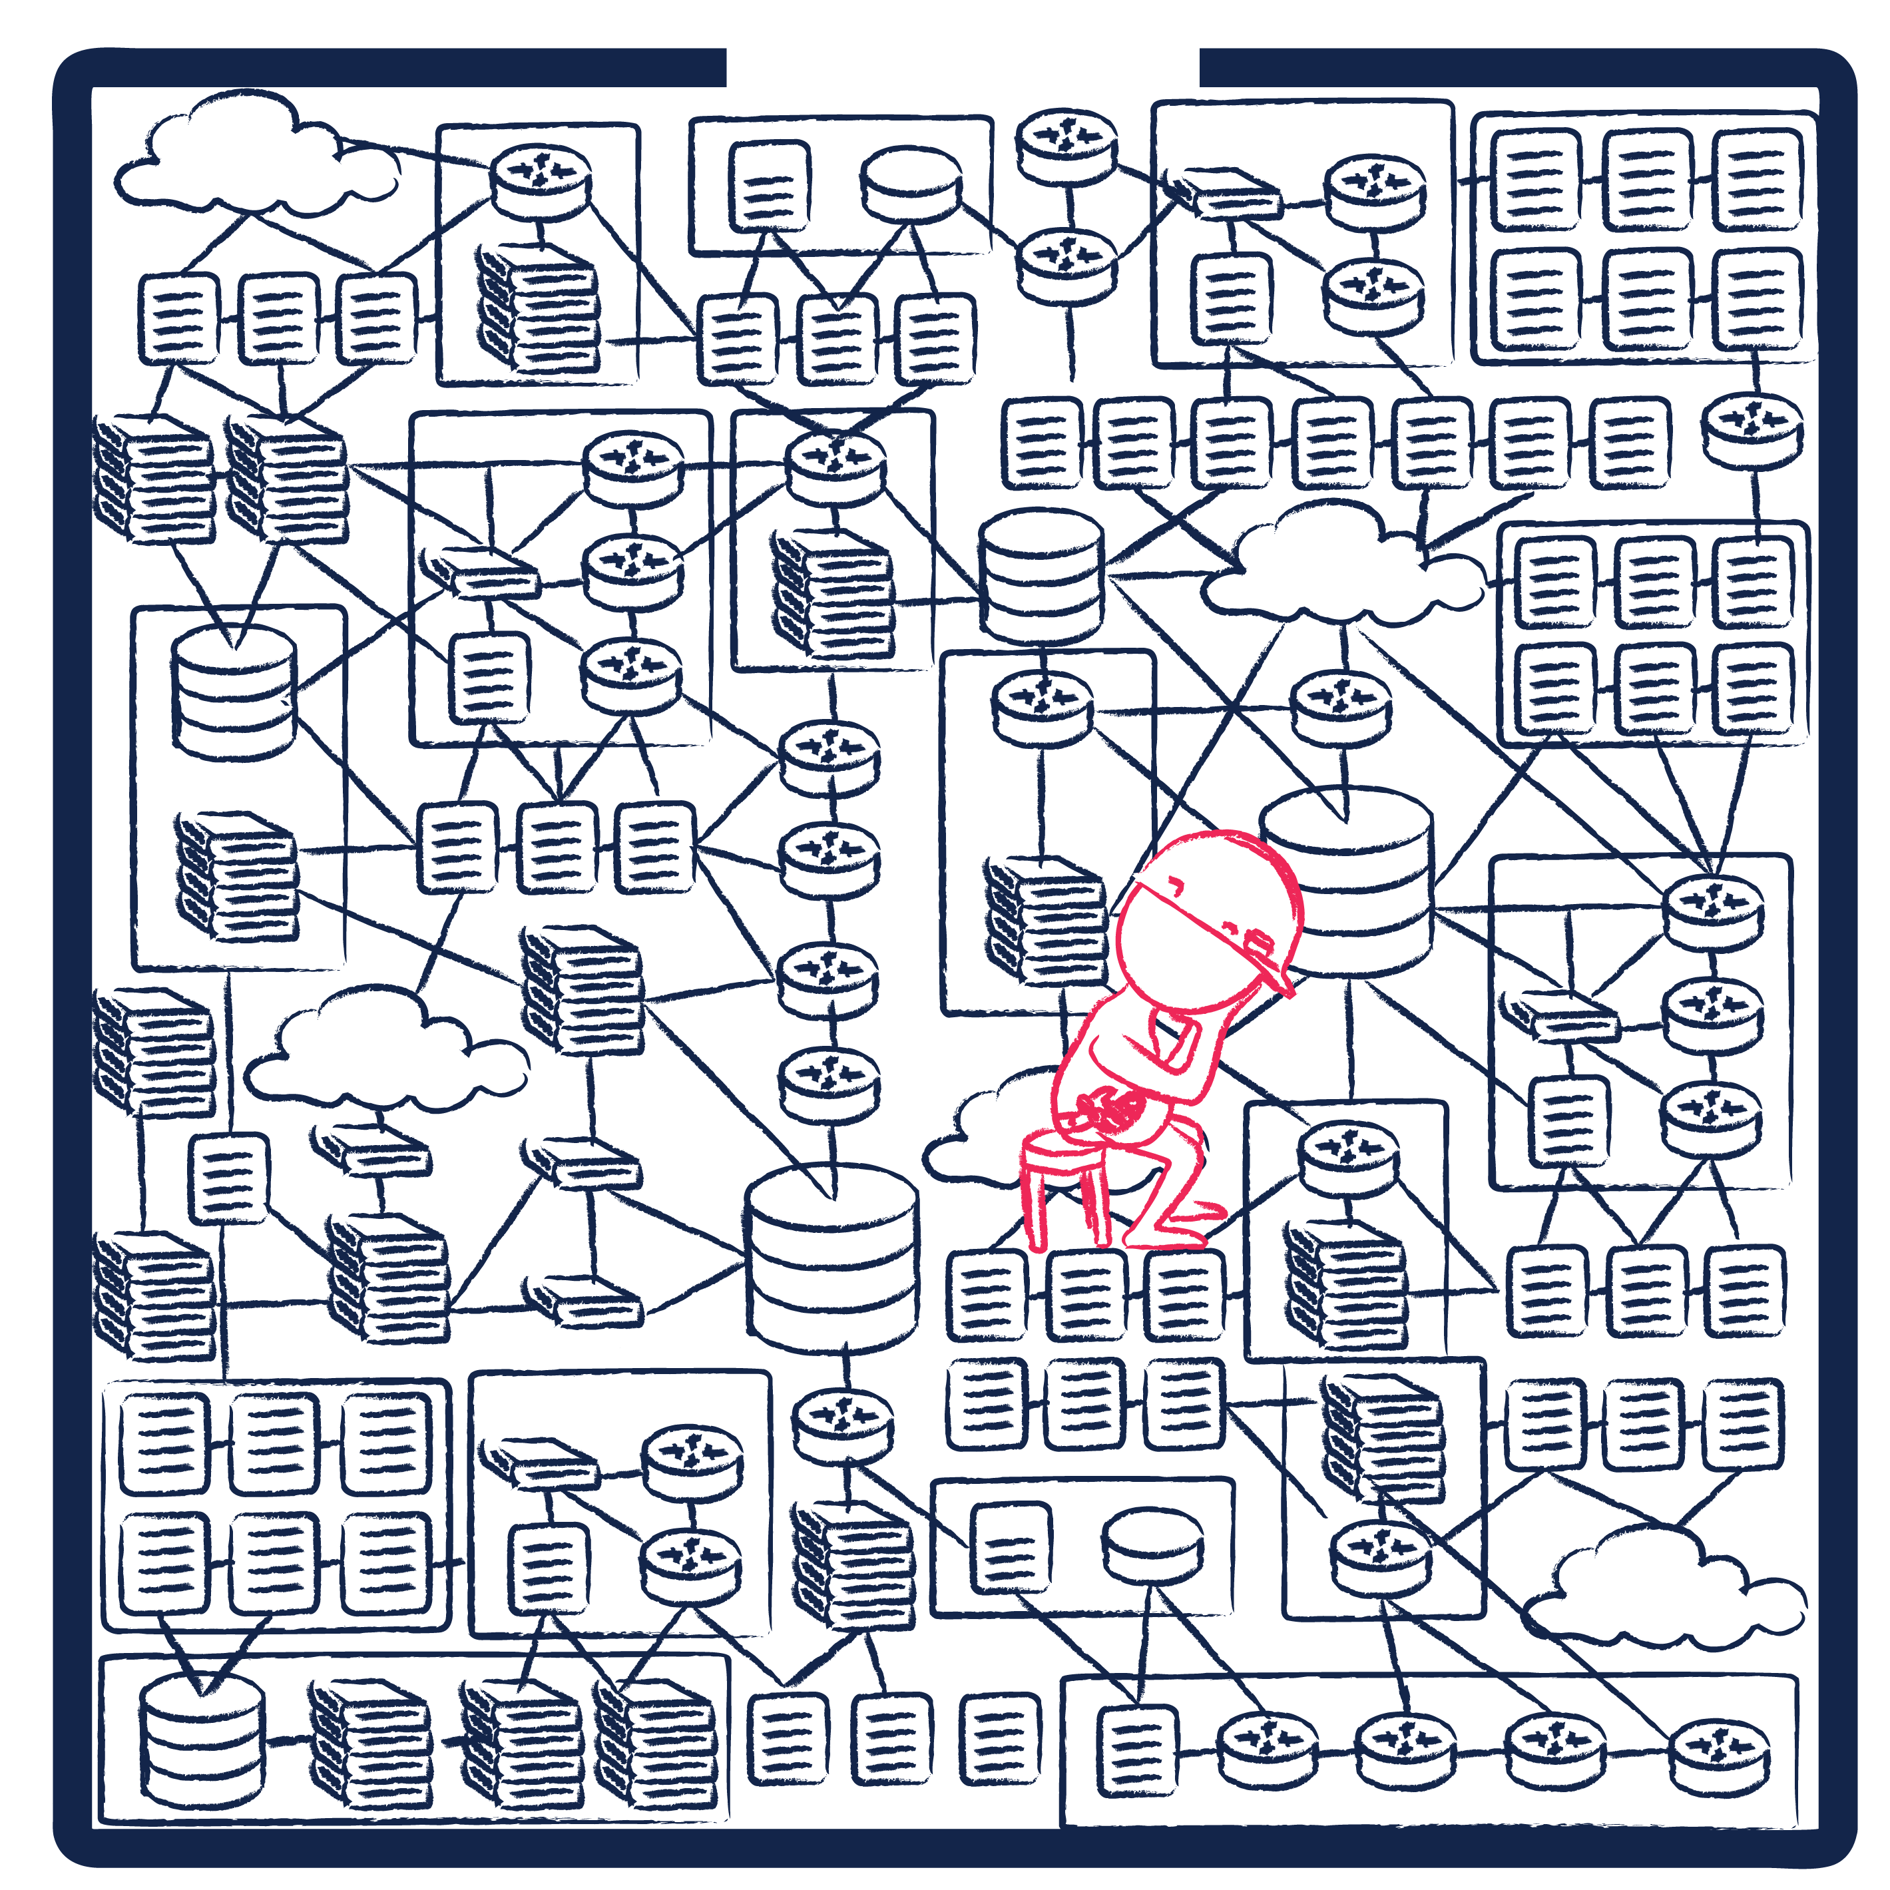
bridges the reliability gap
SDN, Fabric, Multivendor NOS, ACI, NSX, Ansible, Git…
DESIGN,
DEVELOPMENT
& CONFIG,
STAGING
DEPLOYMENT…
All the
problems
are here!
>Is help on the way?
>_
Notes:
Operations teams can’t scale..
Modern, orchestrated networks outpace human analysis.
Operations teams aren’t staffed with computer science majors and software engineers.
Old-school MIB pollers are dead or dying.
Packet capture is expensive and violates privacy directives
Multivendor & software-defined networks make the problem worse!
Learning CI/CD pipelines and data p and toolchains consumes too much time!

Slide 5
≠
Operating
Networks
Building Networks

Slide 6
Network Reliability Engineering requires automation
Automation:
operations
done in
software
Notes:
Automation is Just Operations done in software

Slide 7


: the fast path to NRE in network operations
Performance Monitoring Automation
DESIGN,
DEVELOPMENT
& CONFIG,
STAGING
DEPLOYMENT…
Every data source is a
telemetry stream.

Slide 8
automates monitoring & operations workflows
DESIGN|CONFIGURATION|DEPLOYMENT
OPERATIONS & MONITORING
We do this.

Slide 9

Next-Gen Telemetry &
NSG Smart Inspection
Performance Monitoring Automation
< … >
te·lem·e·try /təˈlemətrē/: automated collection and analysis of high-quality measurements directly from elements.
Compute
Network
Storage
SaaS automation that automatically:
Discovers infrastructure,
Reasons on the data,
Infers intent on new & existing systems,
Monitors availability & reliability
Notes:
Telemetry is used to obtain data on the internal functioning of missiles, rockets, unmanned planes, satellites, and probes, providing data on such factors as position, altitude, and speed as well as conditions like temperature, air pressure, wind speed, and radiation. Weather forecasters rely on telemetry to map weather patterns. Astronauts on the space shuttle are monitored with telemetry that measures and transmits readings on their blood pressure, respiration, and heart rates. Similar kinds of telemetry are used by biologists to study animals in the wild and keep track of their populations and movements. Telemetry is also widely used in modern agriculture, often to regulate irrigation.

Slide 10






Network Reliability Engineering with
Smart Inspection transforms any data or information source into a telemetry stream.
Search your network like you search the web
Integrated Grafana service enables instant & customizable dashboard
Smart Inspection
Mgmt & Control Plane
Data Link Data
& System Events
End manual & offline documentation with auto-mapping & real-time topology
Network-aware algorithms & business-logic trigger root-cause alerts
Active ICMP Probes
Next-Gen Inband Telemetry
API Telemetry
Telemetry Applications
Log and CLI events
Query
Alert Monitors
Views
Tagging
Composite Metrics
Reports
Notes:
Root Cause Alerting: Alerts operate on NetSpyGlass collected monitoring data which is evaluated against user-defined conditions to trigger notifications.
Real-Time: Gain granular visibility into network state; collect, process, store monitoring data and see parametric values in context as map overlays.
Historical Maps: Visually display historical monitoring data in the context of network state and topology as devices/connections change over time.
Replaces legacy fault management servers
Reduces the need for:
Performance management probes
Traditional pollers and DB clusters

Slide 11


Network Reliability Engineering with
Massively scalable source of operational truth enables truly reliable networks.
Probe
Agents run inside campus, remote sites, data center
NSG Service runs in the cloud,
multi-region & multi-cloud
Providers
& VPCs
Agent
Telemetry
Agent
Managed
Network
Probe
Telemetry: Management Data,,
Control Plane Data
Link Data
System Events
(no taps, no capture)
---
optional active probes
Agent
Source of
operational truth
with 99.999% availability
Notes:
Control Plane
Flow Metrics
Packet Data

Slide 12

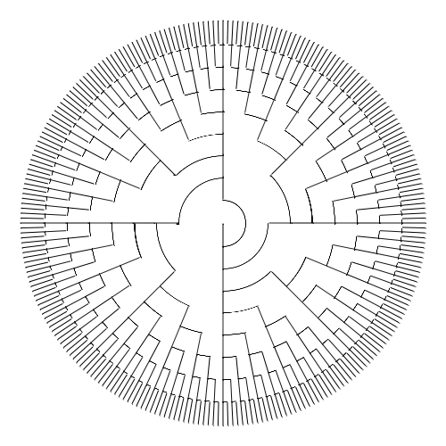

System
User
Docker Stack
Security Proxy
SSH
SQL DB
Internal Load Balancer
Python
NSGer
Runtime Service
TS DB
Logging
NSG Instance 1, 2, 3 → NSG Instance N
NSG Central
(status)

Slide 13
How use over time grows
1
Day 1
Smart Inspection
Orchestrated Discovery
SpyGlass Analytics
Automatic Device Discovery & Network Mapping
Week 1
Automated Dashboard, Search & Tagging
1-2 Months
Search & NSQL Indexed Views
NRE Alert Monitors
Real-Time & Time Series Maps
2
Source of Truth Alert Monitors baked into workflows
3
2-3 Quarters
Deploy SRE style, Business-level Monitoring & Analysis
Inferred Intent & Operational Truth
NRE-Application Platform
4
1-2 Years
Next-Gen Telemetry enables low-latency, INT use cases
Immediate Impact,
Long Term Value
Summer 2020 🕐
Next-Gen Telemetry
5
Mapping, Alerts, Metrics expands to “closed loop” remediation
Fall 2020 🕐

Slide 14
Use Cases
Automate large-scale monitoring with Smart Inspection
(1) Automate toil
(2) Stop documenting and just look
(3) Search your network like you search the web.
Managing Events with Algorithms
Add missing business impact logic
(2) network-aware algorithms handle alerts
(3) Cure alert fatigue.
Automating Multivendor Monitoring
Discover operational truth
(2) Normalize vendor jargon into NSG variables
(3) Zero-touch adds & changes.

Slide 15

performance monitoring automation:
Moves network operations to a SaaS cloud
Real-time network mapping
Monitoring & analytics
Workflow automation
Builds an operational source of truth
  It’s Google Maps
  for networks.
Notes:
Control Plane
Flow Metrics
Packet Data

Slide 16
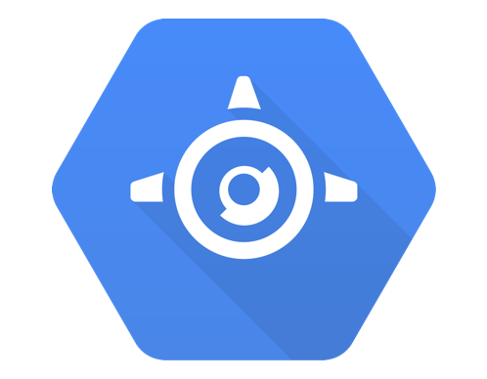
performance monitoring automation:
Telemetry changes everything.
< … >
Compute
Network
Storage
  It’s Google Maps
  for networks.
  It’s Google App Engine
  for networks.

Slide 17
Pricing Summary
Starts @:
$250/device/year
(volume discounts @500 devices)
Performance Monitoring Automation
Notes:
SaaS:
Deployed at AWS and Azure
Subscription with advanced billing per annum
Bulk discounts for large networks or multi-year commitments
2000 devices: $300K/yr
4000 devices: $400K/yr
GTM:
Targeting NPMD budget to start
Defining NetOps/Net Automation segment overtime
Large enterprise and cloud providers with a dedicated network team.

Slide 18


Impact of Reliability Engineering in Networking
“NetSpyGlass vastly reduces the amount of toil for operators to monitor the network. We have gone from exerting a
lot of effort with very little impact to very little effort having a large impact.”
Network wide monitoring systems
SNMP polling to business alerting
Integrated & Grafana dashboards
Automated biz-level monitor
Multivendor SD-WAN
3000+ devices
10000+ devices

Slide 19
performance monitoring automation:
Programmable NRE Platform (in-service Python & REST)
Automatic network mapping
Performance & error monitoring
Analytics, dashboards, reporting
Root-cause alerts & Workflow automation
Operational source of truth
←Monitoring Automation for Networks
A place to run NRE Apps in the cloud→
Transforms network data into a telemetry stream
Gives network engineers super-human powers
Defines the fast path to NRE in network operations

Slide 20

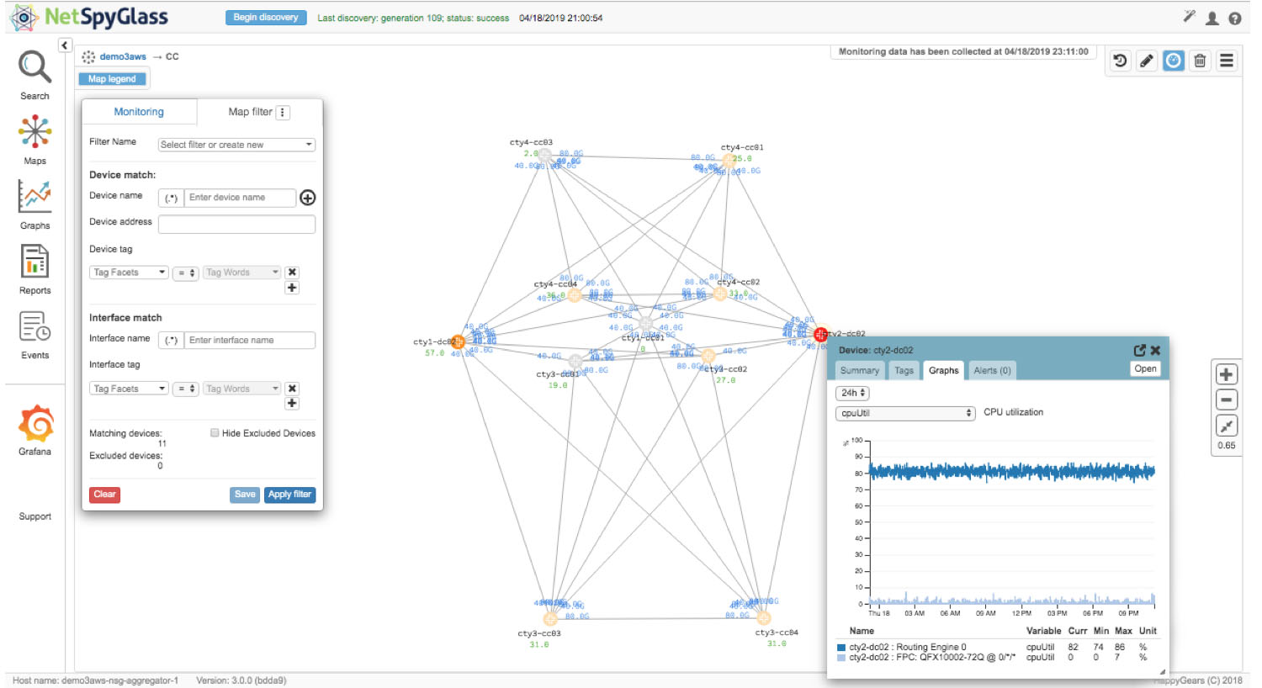
RELIABILITY
∨
Network Engineering
www.netspyglass.com/demo

Slide 21
Appendix III: Team & Technology
Performance Monitoring Automation

Slide 22



Shyam, CEO
Vadim, Founder & CTO
Andrew, CMO
https://www.linkedin.com/in/shyam-davuluru-5994521/
https://www.linkedin.com/in/vadim-kurland-26234/
https://www.linkedin.com/in/andrewrharding/
Aruba Networks | Cumulus Networks | Google | Healtheon/WebMD | Juniper | Neoteris | NETSCOUT/Danaher

Slide 23
